Slide 1
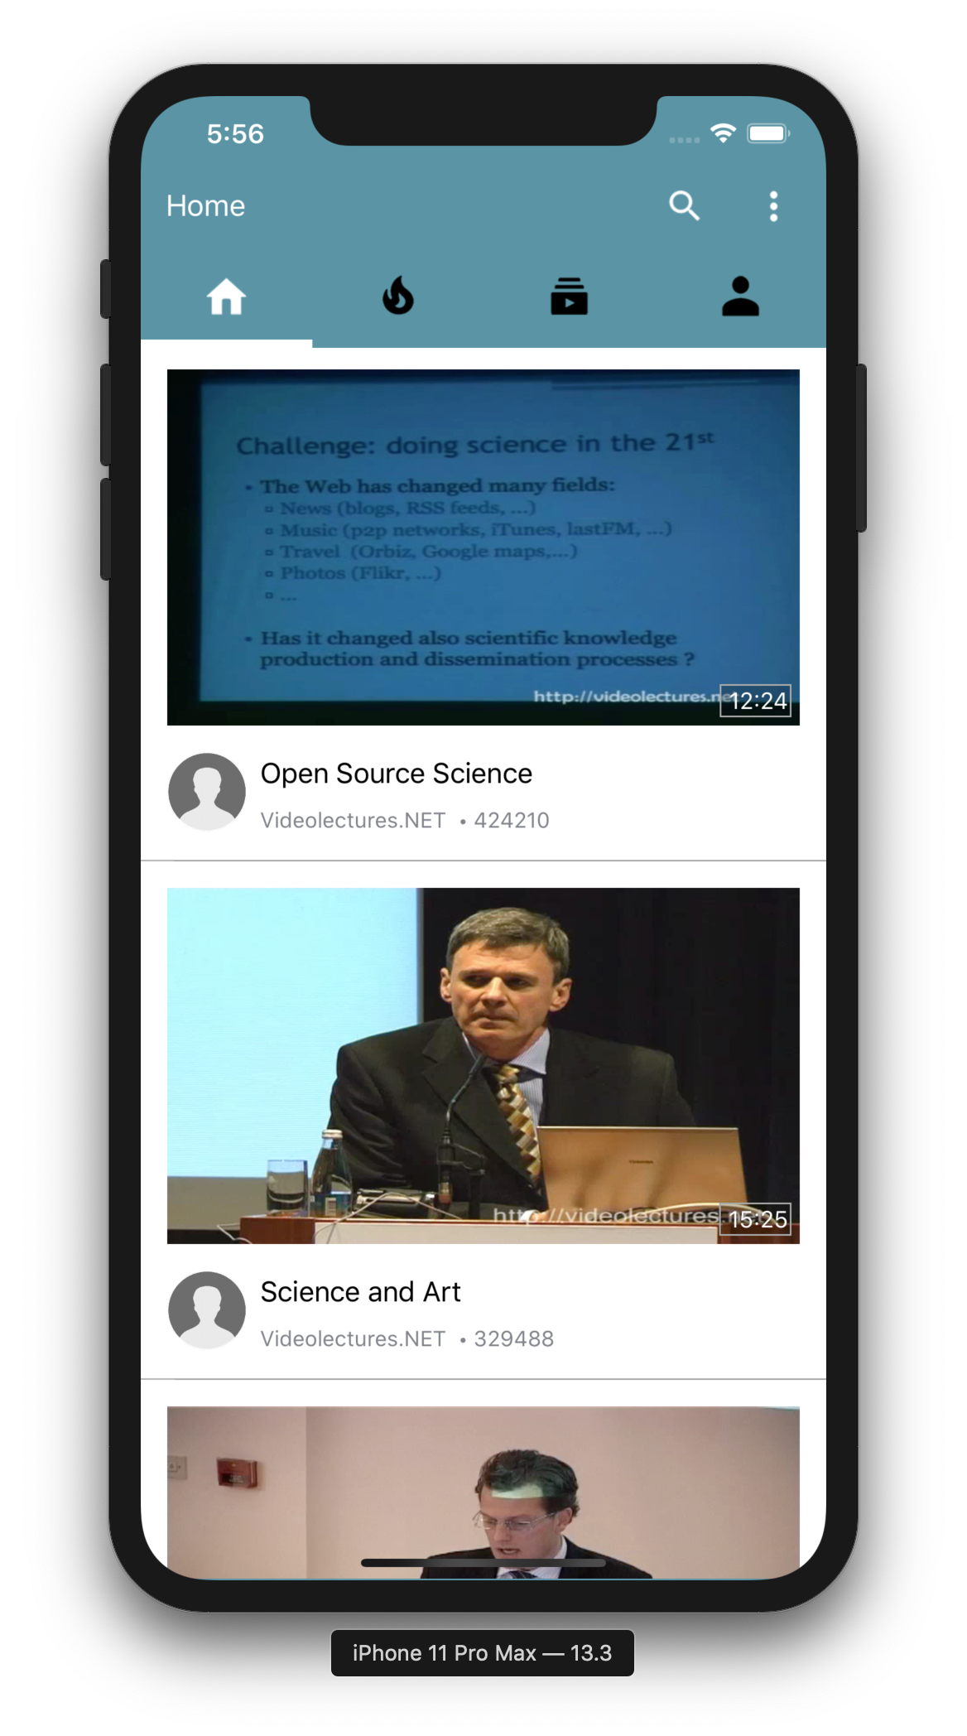
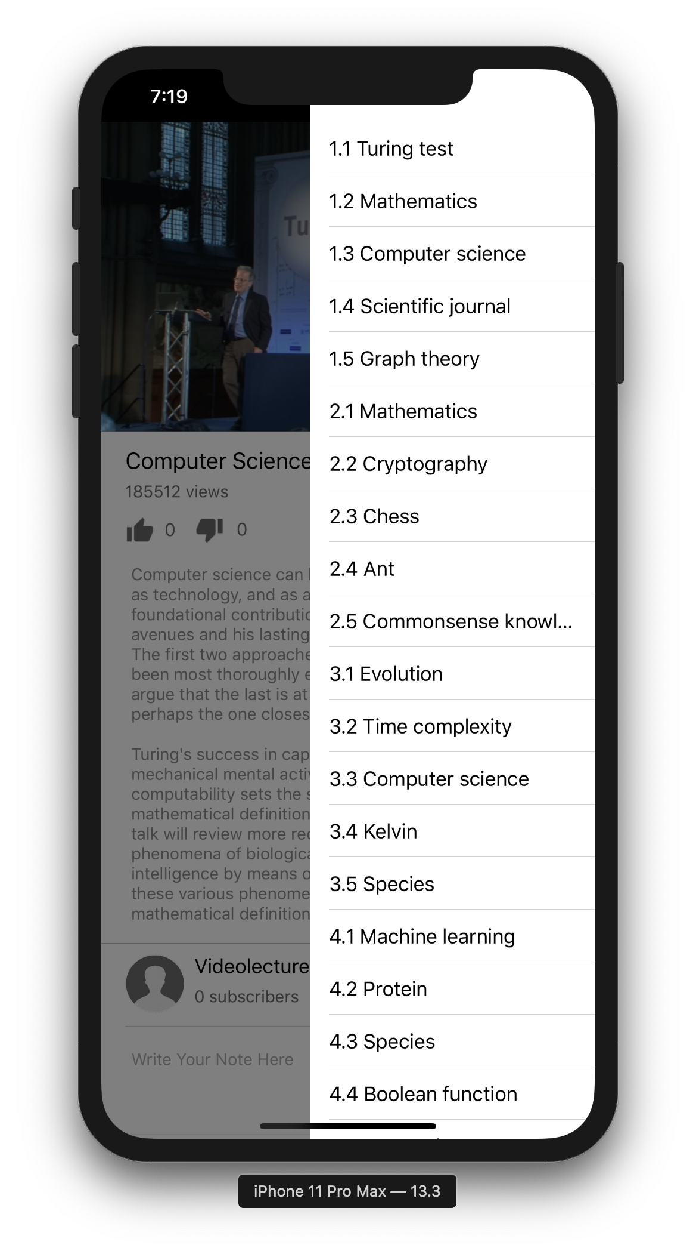
Team 4 : Patrick Wu, Yinrui Hu

Slide 2






Introduction
Main Toolchain
Abstract
Technology
X5GON is an industrial leading Open Education Resource Provider. In this project, we worked with the UCL’s X5GON research team to deliver a mobile application that provides users with an authentic and mobile-friendly X5GON experience and learning materials catered to their needs.
With this project, the X5Learn system would be able to attract more customers from the mobile platform and enable its users to have all their customised X5Learn experience at hand anytime, anywhere.
Used Swift as our main language, Xcode and its toolchains as our main SDK in our project.
Designed our software with the classic MVC Architecture.
Utilised design patterns including Prototype Pattern, Adapter Pattern and Builder Pattern.
Incorporated on SwiftSoup, an external parser for HTML, together with our own algorithm to analyse changing API endpoints on the fly and self-adapt the code.
Deployed Jazzy to generate our documentation website.
Tested APIs and App UIs with XCTest
Pipelined CI/CD with Travis
Dependencies
CI/CD Provider
Code Hosting

Slide 3
Achievement
ID | Description | Priority | State | Contributors
1 | View all types of OER | Must | ☑️ | Patrick
2 | Suggest relevant OERs and show them below the OER that is currently on display | Must | ☑️ | Patrick
3 | Play or pause an OER video | Must | ☑️ | Patrick
4 | View a specific OER and its details when users press it | Must | ☑️ | Patrick
5 | Bookmark a specific OER | Must | ☑️ | Patrick
6 | Add notes to the OER when they are on display | Must | ☑️ | Patrick / Felix

Slide 4
Achievement
ID | Description | Priority | State | Contributors
7 | Show the person or organisation who uploads the OER material | Must | ☑️ | Patrick
8 | Search X5GON OER collections for keywords | Must | ☑️ | Patrick
9 | View their browsing history | Must | ☑️ | Patrick
10 | Full screen (focus) mode to view OERs | Must | ☑️ | Patrick
11 | Rate an OER by pressing the like and dislike button | Must | ☑️ | Patrick
12 | Login and logout of their accounts. | Should | ☑️ | Patrick

Slide 5
Achievement
ID | Description | Priority | State | Contributors
13 | Buffer users’ notes for a specific OER and send them to the backend of X5GON. | Should | ☑️ | Patrick
14 | Preload the video shown on the lists for responsiveness. | Should | ☑️ | Patrick
15 | Provide different main pages, including trending, subscribed contents. | Should | ☑️ | Patrick / Felix
16 | Create a simulated backend to pre-develop certain features | Should | ☑️ | Patrick
17 | Deploy this software on different platforms, e.g. iPhone, iPad | Could | ☑️ | Patrick
18 | Allow users to report inappropriate content | Could | ☑️ | Patrick

Slide 6
Achievement
ID | Description | Priority | State | Contributors
19 | Continuous Integration with Travis | Could | ☑️ | Patrick
20 | Introduce unit testing to the Application | Could | ☑️ | Felix / Patrick
21 | Have captions or translations for captions | Won’t
22 | Allow users to upload OER from our app | Won’t
23 | Allow users to collaborative edit notes | Won’t
24 | Allow commenting on OER | Won’t
25 | Show users’ note to other users | Won’t
26 | Keep suggesting the same OER to same use | Won’t
Key Functionalities : |  |  | 100 %
Optional Functionalities |  |  | 100 %
*Certain modifications are made to the MoSCoW list upon mutual agreement with the client during the project.

Slide 7
Contribution
Part Of Project | Patrick Wu | Yinrui Hu
Client Liaison | 80% | 20%
Requirement Analysis | 60% | 40%
Research | 90% | 10%
UI Design | 50% | 50%
Prototyping | 30% | 70%
Programming | 80% | 20%
Documentation | 10% | 90%
Presentation | 50% | 50%
Blog | 70% | 30%
Testing | 10% | 90%
Bi-Weekly Reports | 70% | 30%
Project Website | 80% | 20%
Poster Design | 80% | 20%
Video Editing | 80% | 20%
 | Patrick Wu | Yinrui Hu
Overall Contribution | 60% | 40%
Main Roles | Lead Developer, Researcher | Tester, UI Designer, Video Editor

